Slide 1

Introduction to Probability and Statistics
Twelfth Edition
Robert J. Beaver • Barbara M. Beaver • William Mendenhall
Presentation designed and written by:
Barbara M. Beaver

Slide 2
Introduction to Probability and Statistics
Twelfth Edition
Chapter 7
Sampling Distributions
Some graphic screen captures from Seeing Statistics ®
Some images © 2001-(current year) www.arttoday.com

Slide 3
Introduction
Parameters are numerical descriptive measures for populations.
  For the normal distribution, the location and shape are described by μ and σ.
  For a binomial distribution consisting of n trials, the location and shape are determined by p.
Often the values of parameters that specify the exact form of a distribution are unknown.
You must rely on the sample to learn about these parameters.

Slide 4
Sampling
Examples:
A pollster is sure that the responses to his “agree/disagree” question will follow a binomial distribution, but p, the proportion of those who “agree” in the population, is unknown.
An agronomist believes that the yield per acre of a variety of wheat is approximately normally distributed, but the mean μ and the standard deviation σ of the yields are unknown.
If you want the sample to provide reliable information about the population, you must select your sample in a certain way!

Slide 5
Simple Random Sampling
The sampling plan or experimental design determines the amount of information you can extract, and often allows you to measure the reliability of your inference.
Simple random sampling is a method of sampling that allows each possible sample of size n an equal probability of being selected.

Slide 6

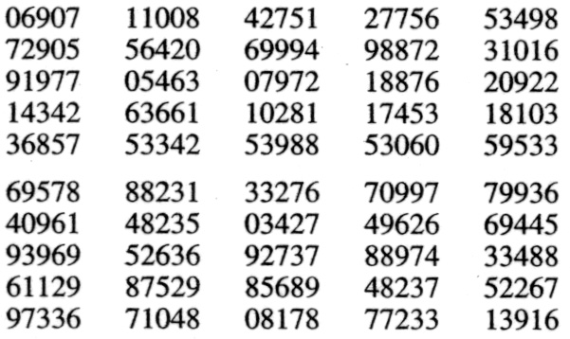
Example
There are 89 students in a statistics class. The instructor wants to choose 5 students to form a project group. How should he proceed?
Give each student a number from 01 to 89.
Choose 5 pairs of random digits from the random number table.
If a number between 90 and 00 is chosen, choose another number.
The five students with those numbers form the group.

Slide 7
Types of Samples
Sampling can occur in two types of practical situations:
Observational studies: The data existed before you decided to study it. Watch out for
  Nonresponse: Are the responses biased because only opinionated people responded?
  Undercoverage: Are certain segments of the population systematically excluded?
  Wording bias: The question may be too complicated or poorly worded.

Slide 8
Types of Samples
Sampling can occur in two types of practical situations:
2. Experimentation: The data are generated by imposing an experimental condition or treatment on the experimental units.
  Hypothetical populations can make random sampling difficult if not impossible.
  Samples must sometimes be chosen so that the experimenter believes they are representative of the whole population.
  Samples must behave like random samples!

Slide 9
Other Sampling Plans
There are several other sampling plans that still involve randomization:
Stratified random sample: Divide the population into subpopulations or strata and select a simple random sample from each strata.
Cluster sample: Divide the population into subgroups called clusters; select a simple random sample of clusters and take a census of every element in the cluster.
3. 1-in-k systematic sample: Randomly select one of the first k elements in an ordered population, and then select every k-th element thereafter.

Slide 10

Examples
Divide California into counties and
take a simple random sample within each county.
Divide California into counties and take a simple random sample of 10 counties.
Divide a city into city blocks, choose a simple random sample of 10 city blocks, and interview all who live there.
Choose an entry at random from the phone book, and select every 50th number thereafter.
Stratified
Cluster
Cluster
1-in-50 Systematic

Slide 11
Non-Random Sampling Plans
There are several other sampling plans that do not involve randomization. They should NOT be used for statistical inference!
Convenience sample: A sample that can be taken easily without random selection.
  People walking by on the street
Judgment sample: The sampler decides who will and won’t be included in the sample.
Quota sample: The makeup of the sample must reflect the makeup of the population on some selected characteristic.
  Race, ethnic origin, gender, etc.

Slide 12
Sampling Distributions
Numerical descriptive measures calculated from the sample are called statistics.
Statistics vary from sample to sample and hence are random variables.
The probability distributions for statistics are called sampling distributions.
In repeated sampling, they tell us what values of the statistics can occur and how often each value occurs.

Slide 13

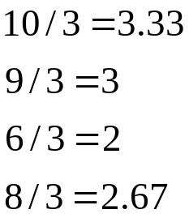
Sampling Distributions
Definition: The sampling distribution of a statistic is the probability distribution for the possible values of the statistic that results when random samples of size n are repeatedly drawn from the population.
Each value of x-bar is equally likely, with probability 1/4
Population: 3, 5, 2, 1
Draw samples of size n = 3 without replacement
Possible samples
3, 5, 2
3, 5, 1
3, 2, 1
5, 2, 1
p(x)
1/4
x
2 3

Slide 14

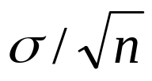
Sampling Distributions
Sampling distributions for statistics can be
Approximated with simulation techniques
Derived using mathematical theorems
The Central Limit Theorem is one such theorem.
Central Limit Theorem: If random samples of n observations are drawn from a nonnormal population with finite μ and standard deviation σ , then, when n is large, the sampling distribution of the sample mean is approximately normally distributed, with mean μ and standard deviation
. The approximation becomes more accurate as n becomes large.

Slide 15

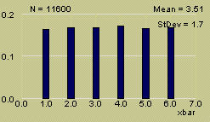
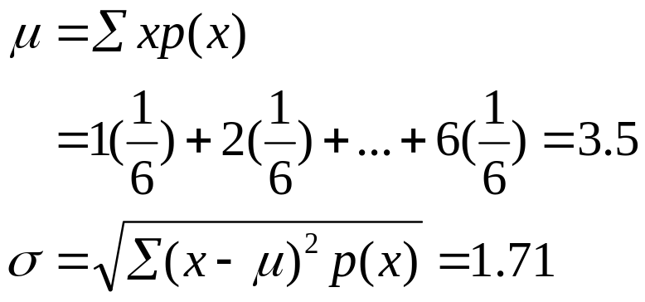
Example
MY
APPLET
Toss a fair coin n = 1 time. The distribution of x the number on the upper face is flat or uniform.

Slide 16
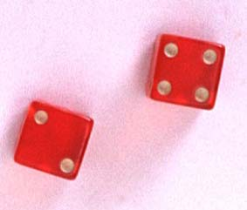
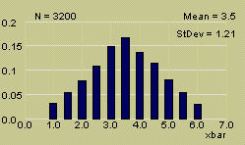
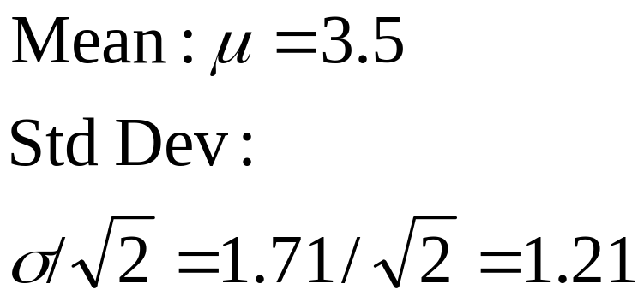
Example
MY
APPLET
Toss a fair coin n = 2 times. The distribution of x the average number on the two upper faces is mound-shaped.

Slide 17

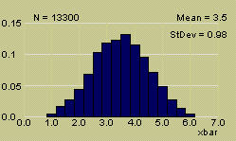
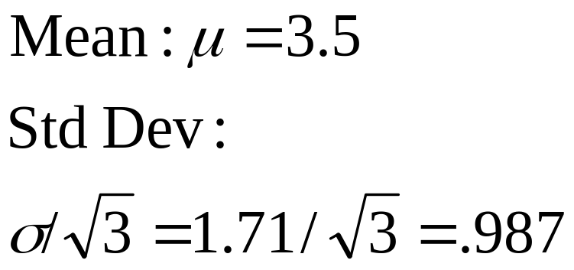
Example
MY
APPLET
Toss a fair coin n = 3 times. The distribution of x the average number on the two upper faces is approximately normal.

Slide 18
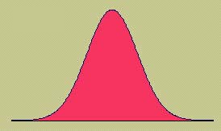
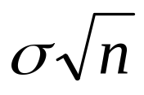
Why is this Important?
The Central Limit Theorem also implies that the sum of n measurements is approximately normal with mean nμ and standard deviation .
Many statistics that are used for statistical inference are sums or averages of sample measurements.
When n is large, these statistics will have approximately normal distributions.
This will allow us to describe their behavior and evaluate the reliability of our inferences.

Slide 19

How Large is Large?
If the sample is normal, then the sampling distribution of will also be normal, no matter what the sample size.
When the sample population is approximately symmetric, the distribution becomes approximately normal for relatively small values of n.
When the sample population is skewed, the sample size must be at least 30 before the sampling distribution of becomes approximately normal.

Slide 20

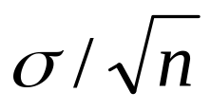
The Sampling Distribution of the Sample Mean
A random sample of size n is selected from a population with mean μ and standard deviation σ.
Τhe sampling distribution of the sample mean will have mean μ and standard deviation .
If the original population is normal, the sampling distribution will be normal for any sample size.
If the original population is nonnormal, the sampling distribution will be normal when n is large.
The standard deviation of x-bar is sometimes called the STANDARD ERROR (SE).

Slide 21
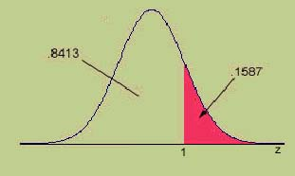
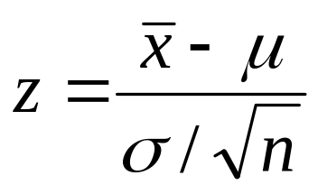
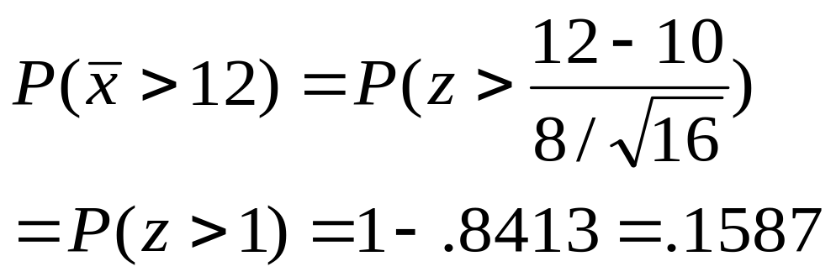
Finding Probabilities for the Sample Mean
If the sampling distribution of is normal or approximately normal, standardize or rescale the interval of interest in terms of
Find the appropriate area using Table 3.
Example: A random sample of size n = 16 from a normal distribution with μ = 10 and σ = 8.

Slide 22


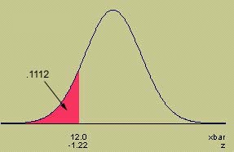
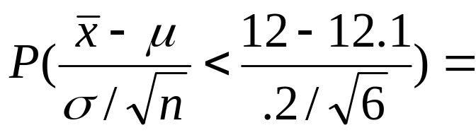
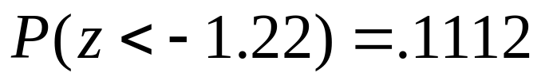
Example
MY
APPLET
A soda filling machine is supposed to fill cans of
soda with 12 fluid ounces. Suppose that the fills are actually normally distributed with a mean of 12.1 oz and a standard deviation of .2 oz. What is the probability that the average fill for a 6-pack of soda is less than 12 oz?

Slide 23
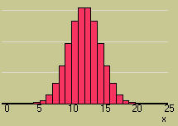
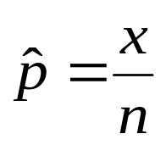

The Sampling Distribution of the Sample Proportion
The Central Limit Theorem can be used to conclude that the binomial random variable x is approximately normal when n is large, with mean np and standard deviation .
The sample proportion, is simply a rescaling of the binomial random variable x, dividing it by n.
From the Central Limit Theorem, the sampling distribution of will also be approximately normal, with a rescaled mean and standard deviation.

Slide 24
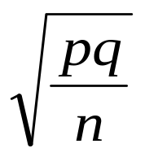
The Sampling Distribution of the Sample Proportion
A random sample of size n is selected from a binomial population with parameter p.
Τhe sampling distribution of the sample proportion,
will have mean p and standard deviation
If n is large, and p is not too close to zero or one, the sampling distribution of will be approximately normal.
The standard deviation of p-hat is sometimes called the STANDARD ERROR (SE) of p-hat.

Slide 25
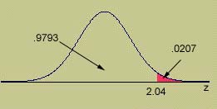
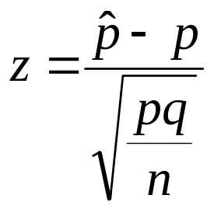
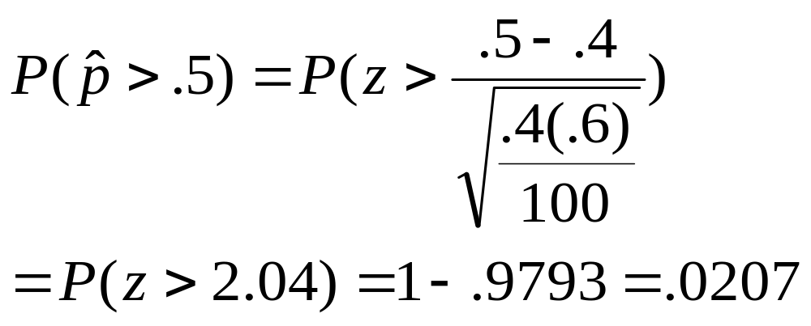
Finding Probabilities for the Sample Proportion
If the sampling distribution of is normal or approximately normal, standardize or rescale the interval of interest in terms of
Find the appropriate area using Table 3.
Example: A random sample of size n = 100 from a binomial population with p = .4.

Slide 26
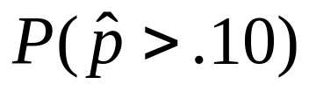
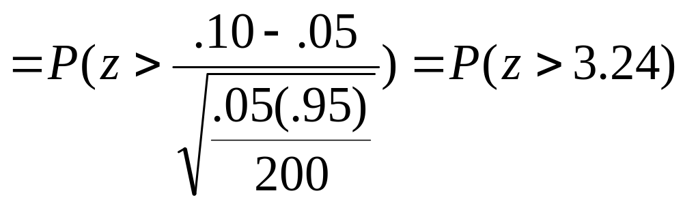

Example
The soda bottler in the previous example claims
that only 5% of the soda cans are underfilled.
A quality control technician randomly samples 200 cans of soda. What is the probability that more than 10% of the cans are underfilled?
n = 200
S: underfilled can
p = P(S) = .05
q = .95
np = 10 nq = 190
This would be very unusual, if indeed p = .05!
OK to use the normal approximation

Slide 27
Statistical Process Control
The cause of a change in the variable is said to be assignable if it can be found and corrected.
Other variation that is not controlled is regarded as random variation.
If the variation in a process variable is solely random, the process is said to be in control.
If out of control, we must reduce the variation and get the measurements of the process variable within specified limits.

Slide 28
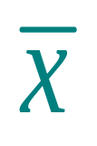
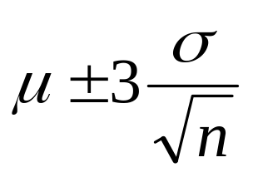
The Chart for
Process Means
At various times during production, we take a sample of size n and calculate the sample mean .
According to the CLT, the sampling distribution of should be approximately normal; almost all of the values of should fall into the interval
If a value of falls outside of this interval, the process may be out of control.

Slide 29

The Chart
To create a control chart, collect data on k samples of size n. Use the sample data to estimate μ and σ.
The mean μ is estimated with , the grand average of all the sample statistics calculated for the nk measurements on the process variable.
The standard deviation σ is estimated by s, the standard deviation of the nk measurements.
Create the control chart, using a centerline and control limits.

Slide 30
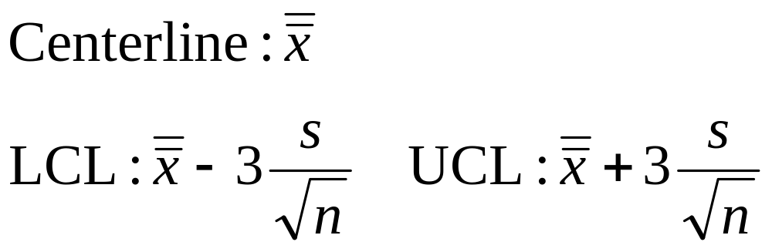
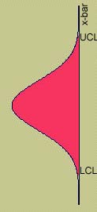
The Chart
When a sample mean falls outside the control limits, the process may be out of control.

Slide 31
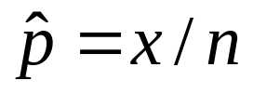
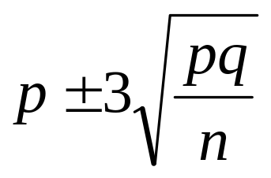
The p Chart for
Proportion Defective
At various times during production, we take a sample of size n and calculate the proportion of defective items, .
According to the CLT, the sampling distribution of should be approximately normal; almost all of the values of should fall into the interval
If a value of falls outside of this interval, the process may be out of control.

Slide 32
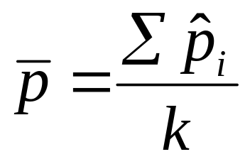
The p Chart
To create a control chart, collect data on k samples of size n. Use the sample data to estimate p.
The population proportion defective p is estimated with
the grand average of all the sample proportions calculated for the k samples.
Create the control chart, using a centerline and control limits.

Slide 33
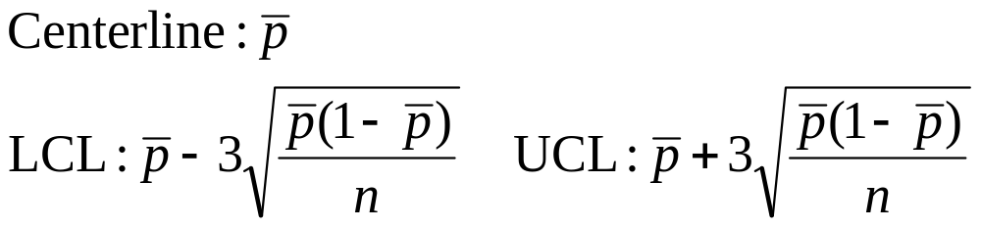
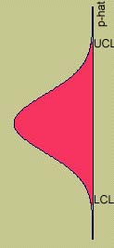
The p Chart
When a sample proportion falls outside the control limits, the process may be out of control.

Slide 34
Key Concepts
I. Sampling Plans and Experimental Designs
1. Simple random sampling
a. Each possible sample is equally likely to occur.
b. Use a computer or a table of random numbers.
c. Problems are nonresponse, undercoverage, and wording bias.
2. Other sampling plans involving randomization
a. Stratified random sampling
b. Cluster sampling
c. Systematic 1-in-k sampling

Slide 35
Key Concepts
3. Nonrandom sampling
a. Convenience sampling
b. Judgment sampling
c. Quota sampling
II. Statistics and Sampling Distributions
1. Sampling distributions describe the possible values of a
statistic and how often they occur in repeated sampling.
2. Sampling distributions can be derived mathematically,
approximated empirically, or found using statistical theorems.
3. The Central Limit Theorem states that sums and averages of
measurements from a nonnormal population with finite mean μ and standard deviation σ have approximately normal distributions for large samples of size n.

Slide 36

Key Concepts
III. Sampling Distribution of the Sample Mean
1. When samples of size n are drawn from a normal population
with mean μ and variance σ ², the sample mean has a
normal distribution with mean μ and variance σ ²/n.
2. When samples of size n are drawn from a nonnormal
population with mean μ and variance σ ², the Central Limit
Theorem ensures that the sample mean will have an
approximately normal distribution with mean μ and variance
σ ² /n when n is large (n ≥ 30).
3. Probabilities involving the sample mean μ can be calculated
by standardizing the value of using

Slide 37

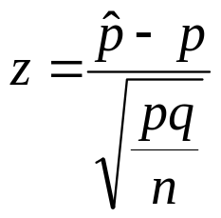
Key Concepts
IV. Sampling Distribution of the Sample Proportion
When samples of size n are drawn from a binomial population with parameter p, the sample proportion will have an approximately normal distribution with mean p and variance pq /n as long as np > 5 and nq > 5.
2. Probabilities involving the sample proportion can be calculated by standardizing the value using

Slide 38

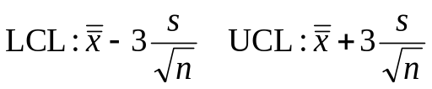
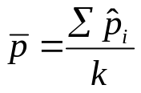
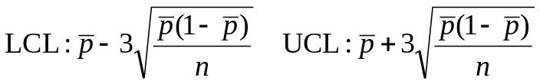
Key Concepts
V. Statistical Process Control
1. To monitor a quantitative process, use an chart. Select k samples of size n and calculate the overall mean and the standard deviation s of all nk measurements. Create upper and lower control limits as
If a sample mean exceeds these limits, the process is out of control.
2. To monitor a binomial process, use a p chart. Select k samples of size n and calculate the average of the sample proportions as
Create upper and lower control limits as
If a sample proportion exceeds these limits, the process is out of control.

